Slide 1
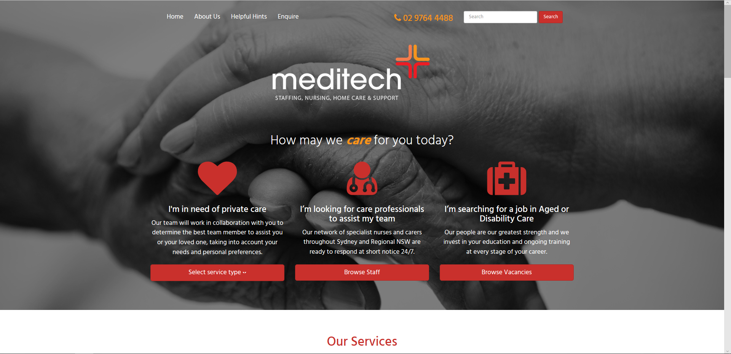
Staff login
Policies & Procedures
Client handbook
Links to staff
Resource portal

Slide 2

Staff resource portal
Access to Roster via a link
to Procura.
Policies &
Procedures
Meditech
News
Rosters
online
Training
Resources
pdf. of newsletter
could include promo
Items such as refer a
friend.
Static list of current staff
Policies & procedures,
opens onto new tab
Access to printed training
Material, videos, assessments
Form linked to
jobs@Meditech.com.au
Allows staff to inform HR of changed
Personal details eg, address, contact details
Update
Personal
Details
Forms
Download
Who’s
Who
Static list of staff
photos, job title and a
brief bio.
List of commonly used
Forms in pdf for download

Slide 3
Policies & procedures
Community
staff policies &
procedures
Residential
staff policies &
procedures
Best practice
principles

Slide 4
Training resources
Support Worker
Induction
Registered Nurse
Induction
Occupational
Health & safety
Manual
handling
Fire &
evacuation
Wound
management
Medication
management
Diabetic care &
management
Infection
control
Dementia
care

Slide 5
Meditech news
Aged care
news
Disability
news
Staff news

Slide 6

Rosters online
Select calendar icon to access your roster.

Slide 7
Forms
Leave request
forms
Incident
reports
Workers
compensation
Timesheets

Slide 8

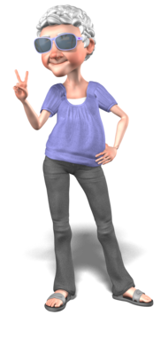





Who’s who
Michelle
BDM
Nathan
HR manager
Edwin
Business manager
Alex
Community RN
Rachael
HCP / Home care Manager
Michael
Managing Director
Aaron
HR / IT support
Insert link from animated image to a bio and real photo for each staff member (“fun” avatar needed for all office staff – total 24)

Slide 9
Update personal details
Update personal
details
Link to jobs@meditechstaffing.com.au to update personal details

